Slide 1
Recommender Systems
Millie Pant
Department of Applied Mathematics and Scientific Computing
Joint faculty, MFS-DSML
Indian Institute of Technology Roorkee

Slide 2
Recommender System
systems designed to recommend things to the user based on various factors.
It takes the user model consisting of ratings, preferences, demographics, etc. and items with its descriptions as input, finds relevant score which is used for ranking, and finally recommends items that are relevant to the user.
The recommender system deals with a large volume of information present by filtering the most important information based on the data provided by a user and other factors that take care of the user’s preference and interest.
It finds out the match between user and item and imputes the similarities between users and items for recommendation.

Slide 3

The Netflix Prize
The mission: Make the company's recommendation engine 10% more accurate
it was the data set -- over 100 million ratings of 17,770 movies from 480,189 customers

Slide 4
Recommender systems
35% of the purchases on Amazon are the result of their recommender system, according to McKinsey.
During the Chinese global shopping festival of November 11, 2016, Alibaba achieved growth of up to 20% of their conversion rate using personalized landing pages, according to Alizila.
Recommendations are responsible for 70% of the time people spend watching videos on YouTube.
75% of what people are watching on Netflix comes from recommendations, according to McKinsey.
Employing a recommender system enables Netflix to save around $1 billion each year, according to this paper written by an executive:

Slide 5
model for Recommendation System
Recommendation system is a facility that involves predicting user responses to options in web applications. Generally the recommendations are as follows:
“You may also like these...”,
“People who liked this also liked...”.

Slide 6
Applications of Recommendation Systems
Product Recommendations: for on-line retailers.
Amazon
Flipkart
Movie Recommendations:
Netflix
Amazon pime.
Personalized Content
Better Product search experience

Slide 7
News Articles:
News services attempt to identify articles of interest to readers, based on the articles that they have read in the past.
The similarity might be based on the similarity of important words in the documents, or on the articles that are read by people with similar reading tastes.
The same principles apply to recommending blogs from among the millions of blogs available, videos on YouTube, or other sites where content is provided regularly

Slide 8
Recommender System
U1
U3
U2
Users
Recommender System
U4
U5
I3
I2
I6
Items
I1
I5
I4

Slide 9
Models for Recommendation System
Recommender System
Content Based
Collaborative Filtering
User Based
Item Based

Slide 10
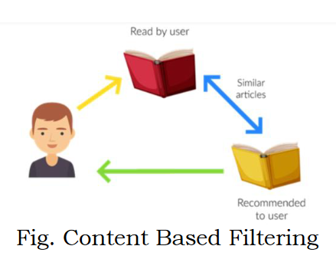
Content-based systems
Relevant items are shown using the content of the previously searched items by the users.
Here content refers to the attribute/tag of the product that the user likes.
Examples.
If a user has watched many “scientific fiction” movies, then the recommender system will recommend movie classified in the database as having the “scientific fiction” genre.
If a user has read a book, then the recommender system will recommend other similar books.

Slide 11
Advantages • Model doesn’t need data of other users since recommendations are specific to a single user. • It makes it easier to scale to a large number of users. • The model can capture the specific Interests of the user and can recommend items that very few other users are interested in. Disadvantages • Feature representation of items is hand-engineered to some extent and requires a lot of domain knowledge. • The model can only make recommendations based on the existing interest of a user.

Slide 12
Collaborative-filtering system
Uses community data from peer groups for recommendations.
This exhibits all those things that are popular among the peers.
Collaborative filtering systems recommend items based on similarity measures between users and/or items.
The items recommended to a user are those preferred by similar users (community data). Eg. When we shop on Amazon it recommends new products saying “Customer who brought this also brought”.

Slide 13
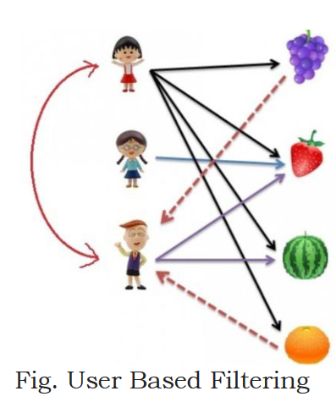
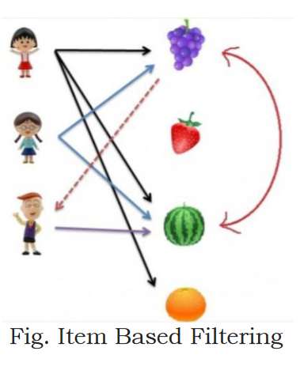

Slide 14
If number of items is greater than number of users go with user-based collaborative filtering as it will reduce the computation power and If number of users is greater than number of items go with item-based collaborative filtering.

Slide 15
Advantages • It works well even if the data is small. • This model helps the users to discover a new interest in a given item but the model might still recommend it because similar users are interested in that item. • No need for Domain Knowledge Disadvantages • It cannot handle new items because the model doesn’t get trained on the newly added items in the database. This problem is known as Cold Start Problem. • The sparsity problem occurs when there is too little information to work with, in order to provide the user base with decent approximations as to which products they would likely prefer. • A gray sheep is a user which has no obvious closest neighbour and seems to rate content in an unpredictable pattern unlike that of any other user.

Slide 16
Implementing Recommendation Systems
Memory based: We use entire user-item data set to generate a Recommendation System. It uses statistical techniques to approximate users or items. Eg. Cosine similarity, Jaccard similarity, Pearson Coefficient, Euclidian distance etc.
Model based: A model of users is developed in an attempt to learn their preferences. Models can be created using ML techniques like regression, clustering, classification etc.

Slide 17
Representation of data
The data is represented as a utility matrix, giving for each user-item pair, a value that represents what is known about the degree of preference of that user for that item.
Values come from an ordered set, e.g., integers 1–5 representing the number of stars that the user gave as a rating for that item.

Slide 18
The Utility Matrix
In a recommendation-system application there are two classes of entities, which are referred to as users and items.
Users have preferences for certain items, and these preferences must be teased out of the data.
We assume that the matrix is sparse, meaning that most entries are “unknown.” An unknown rating implies that we have no explicit information about the user’s preference for the item.

Slide 19
Example: utility matrix, representing users’ ratings of movies on a 1–5 scale
 | HP1 | HP2 | HP3 | TW | SW1 | SW2 | SW3
A | 4 |  |  | 5 | 1
B | 5 | 5 | 4
C |  |  |  | 2 | 4 | 5
D |  | 3 |  |  |  |  | 3

Slide 20
Populating the Utility Matrix
The user can be asked to rate the items.
Movie ratings are generally obtained this way,
some on-line stores try to obtain ratings from their purchasers. Sites providing content,
some news sites or YouTube also ask users to rate items.
This approach is limited in its effectiveness, since generally users are unwilling to provide responses, and the information from those who do may be biased by the very fact that it comes from people willing to provide ratings.

Slide 21
User profile – user behavior
User
Likes an item (rating = 1)
Does not like the item
Often, utility matrix with this kind of data shows 0’s rather than blanks where the user has not purchased or viewed the item.
In this case 0 is not a lower rating than 1; it is no rating at all.
More generally, one can infer interest from behavior other than purchasing.
For example, if an Amazon customer views information about an item, it can be inferred that they are interested in the item, even if they don’t buy it

Slide 22
Item Profiles
Item profile - represents important characteristics of that item.
For example:
The set of actors of the movie.
The director
The year in which the movie was made.
The genre or general type of movie.
Item profile plays an important role in content based recommender system

Slide 23
Dependencies ……………………
 | M1 | M2 | M3 | M4 | M5
User 1 | 3 | 1 | 1 | 3 | 1
User2 | 1 | 2 | 4 | 1 | 3
User 3 | 3 | 1 | 1 | 3 | 1
User 4 | 4 | 3 | 5 | 4 | 4
User 1
User 3
Also
User 2 + User 3 = User 4
What else ???
M5 = Average (M2, M3)
M 1
M 4

Slide 24
 | M1 | M2 | M3 | M4 | M5
User 1 | 3 | 1 | 1 | 3 | 1
User2 | 1 | 2 | 4 | 1 | 3
User 3 | 3 | 1 | 1 | 3 | ?
User 4 | 4 | 3 | 5 | 4 | 4
User 1 = User 3
User 3 also gave 1 star to M5

Slide 25
Categories
 | Horror | Comedy
M1 | 3 | 1
M2 | 1 | 2
M3 | 1 | 4
M4 | 3 | 1
M5 | 1 | 3
 | Horror | Comedy
User1 | Yes | No
User2 | No | Yes
User3 | Yes | No
User4 | Yes | No
User5 | Ys | Yes

Slide 26
 | Horror | Comedy
M1 | 3 | 1
M2 | 1 | 2
M3 | 1 | 4
M4 | 3 | 1
M5 | 1 | 3
 | Horror | Comedy
User1 | Yes | No
User2 | No | Yes
User3 | Yes | No
User4 | Yes | No
User5 | Ys | Yes
 | M1 | M2 | M3 | M4 | M5
User 1 | 3 | 1 | 1 | 3 | 1
User2 | 1 | 2 | 4 | 1 | 3
User 3 | 3 | 1 | 1 | 3 | ?
User 4 | 4 | 3 | 5 | 4 | 4

Slide 27
 | M1 | M2 | M3 | M4 | M5
Horror | 3 | 1 | 1 | 3 | 1
Comedy | 1 | 2 | 4 | 1 | 3
Matrix factorization
 | Horror | Comedy
User1 | Yes | No
User2 | No | Yes
User3 | Yes | No
User4 | Yes | No
User5 | Ys | Yes
 | M1 | M2 | M3 | M4 | M5
User 1 | 3 | 1 | 1 | 3 | 1
User2 | 1 | 2 | 4 | 1 | 3
User 3 | 3 | 1 | 1 | 3 | 1
User 4 | 4 | 3 | 5 | 4 | 4

Slide 28
Quantifying similarity
There are different metrics to compare ratings provided by two viewers and figure out if they have similar tastes.
Two popular methods for measuring distance are:
Jaccard distance and
cosine distance.

Slide 29


Jaccard distance
Jaccard distance is a function of another quantity called Jaccard Similarity.
Jaccard Similarity between sets S and T:
Jaccard distance d(x, y) between sets S and T :

Slide 30
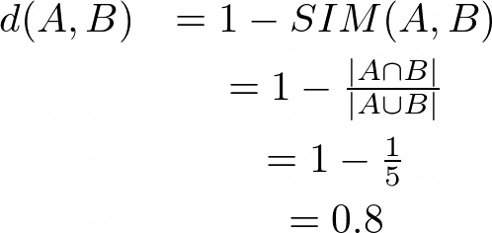
Steps in calculating Jaccard distance
1. Write the ratings given by a users in the form of a set.
A = {HP1, TW, SW1}
B = {HP1, HP2, HP3}
 | HP1 | HP2 | HP3 | TW | SW1 | SW2 | SW3
A | 4 |  |  | 5 | 1
B | 5 | 5 | 4
C |  |  |  | 2 | 4 | 5
D |  | 3 |  |  |  |  | 3
2. Calculate intersection and union
A ⋂ B = {HP1} = 1
A ⋃ B = {HP1, HP2, HP3, TW, SW1} = 5
3. Apply Jaccard’s distance formula
Similarly, the Jaccard distance between A and C is:
d(A, C) = 0.5.

Slide 31
According to this measure, viewers A and C have more similarities between them, as compared to viewers A and B.
This is exactly opposite to what an intuitive analysis of the utility table reveals. Hence, Jaccard distance is not a suitable measure for the kind of data we are considering.

Slide 32
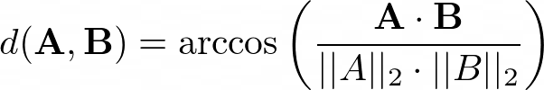
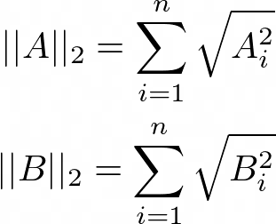
Cosine distance
The cosine distance between two vectors A and B is the angle
d(A, B), given by,
are the L₂-norm of the vectors A and B respectively, and n is the number of products (movies, in this case) up for review. Cosine distance varies between 0 and 180 degrees.

Slide 33
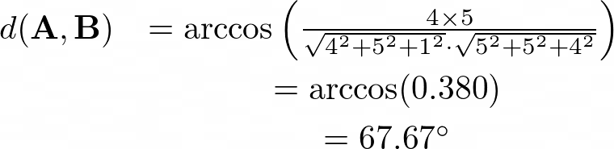
Calculating cosine distance
Cosine distance between viewers A and B, and between viewers A and C.
The vectors corresponding to viewers A, B, and C are:
A = [4, 0, 0, 5, 1, 0, 0]
B = [5, 5, 4, 0, 0, 0, 0]
C = [0, 0, 0, 2, 4, 5, 0].
Cosine distance between A and B is:
Blank spaces are taken as rating zero

Slide 34
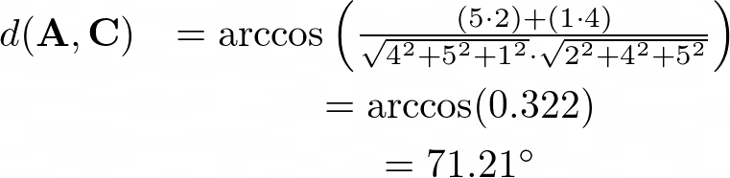
Similarly, the cosine distance between A and C is:
A is slightly closer to B than to C.

Slide 35
Recommendation Inputs
• Explicit feedback – data provided by the user for the purpose of communicating preference, such as star ratings and thumbs up/down
• Implicit feedback – data gathered from other interactions that can be used to infer preference, such as purchases and clicks

Slide 36
Collaborative Filtering (once again)
Collaborative Filtering is a technique or a method to predict a user’s taste and find the items that a user might prefer on the basis of information collected from various other users having similar tastes or preferences.
It takes into consideration the basic fact that if person X and person Y have a certain reaction for some items then they might have the same opinion for other items too.
User Based: Here, we look for the users who have rated various items in the same way and then find the rating of the missing item with the help of these users.
Item Based: Here, we explore the relationship between the pair of items (the user who bought Y, also bought Z). We find the missing rating with the help of the ratings given to the other items by the user.

Slide 37
User-Based Collaborative Filtering
It is a technique used to predict the items that a user might like on the basis of ratings given to that item by the other users who have similar taste with that of the target user.

Slide 38
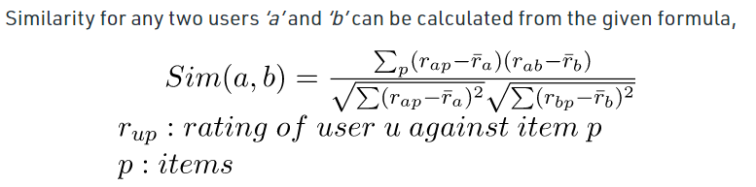
Steps for User-Based Collaborative Filtering
Step 1: Finding the similarity of users to the target user U.
Similarity for any two users ‘a’ and ‘b’ can be calculated from the given formula,
Pearson’s Correlation in peer-based collaborative filtering

Slide 39
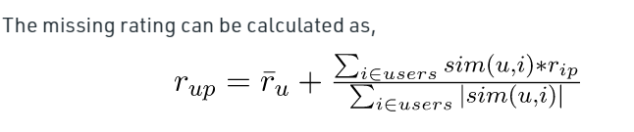
Step 2: Prediction of missing rating of an item
The target user might be very similar to some users and may not be much similar to the others.
Hence, the ratings given to a particular item by the more similar users should be given more weightage than those given by less similar users and so on.
This problem can be solved by using a weighted average approach.
In this approach, multiply the rating of each user with a similarity factor calculated using the above mention formula.

Slide 40
Example:
Consider a matrix which shows four users Alice, U1, U2 and U3 rating on different news apps. The rating range is from 1 to 5 on the basis of users likability of the news app. ‘?’ indicates that the app has not been rated by the user.
Name | Inshorts(I1) | HT(I2) | NYT(I3) | TOI(I4) | BBC(I5)
Alice | 5 | 4 | 1 | 4 | ?
U1 | 3 | 1 | 2 | 3 | 3
U2 | 4 | 3 | 4 | 3 | 5
U3 | 3 | 3 | 1 | 5 | 4

Slide 41
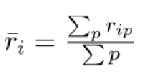
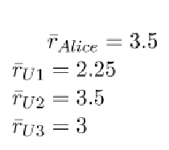
Step 1: Calculating the similarity between Alice and other users
Calculate the averages of the ratings of all the users excluding I5 as it is not rated by Alice
Name | I1 | I2 | I3 | I4 | I5
Alice | 5 | 4 | 1 | 4 | ?
U1 | 3 | 1 | 2 | 3 | 3
U2 | 4 | 3 | 4 | 3 | 5
U3 | 3 | 3 | 1 | 5 | 4
Avg(Alice) | (5+4+1+4)/4 = 14/4 = 3.5
Avg(U1) | (3+1+2+3)/4 = 9/4 = 2.25
Avg(U2) | (4+3+4+3)/4 = 14/4 = 3.5
Avg(U3) | (3+3+1+5)/4 = 12/4 = 3.0

Slide 42
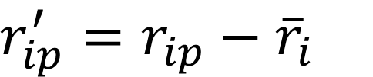
Calculate new ratings:
$r_{ip}^{′}=r_{ip}−$ ${\overline{r}}_{i}$
Name | I1 | I2 | I3 | i4
Alice | 5 – 3.5 = 1.5 | 4 – 3.5 = 0.5 | 1 – 35 = -2.5 | 4 – 3.5 = 0.5
U1 | 3 – 2.25 = 0.75 | 1 – 2.25 = -1.25 | 2 – 2.25 = 0.25 | 3 – 2.25 = 0.75
U2 | 4 – 3.5 = 0.5 | 3 – 3.5 = -0.5 | 4– 3.5 = 0.5 | 3– 3.5 = -0.5
U3 | 3 – 3 = 0 | 3– 3 = 0 | 1– 3 = -2 | 5 – 3 = 2

Slide 43
New rating matrix
Name | I1 | I2 | I3 | I4
Alice | 1.5 | 0.5 | -2.5 | 0.5
U1 | 0.75 | -1.25 | -0.25 | 0.75
U2 | 0.5 | -0.5 | 0.5 | -0.5
U3 | 0 | 0 | -2 | 2

Slide 44
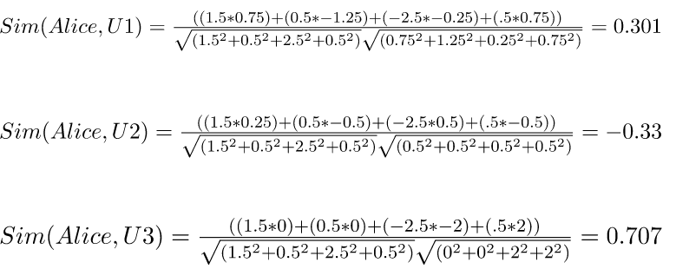
Calculating the similarity between Alice and all the other users.

Slide 45
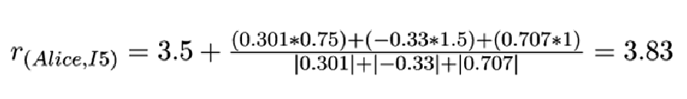
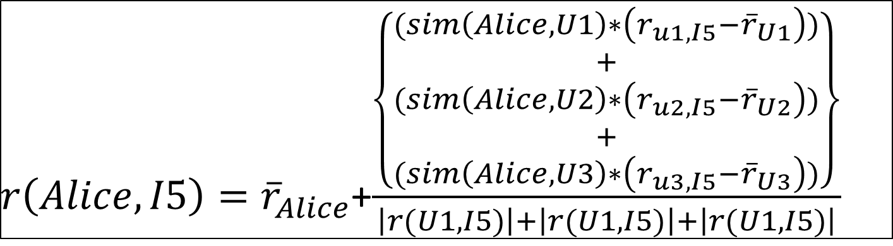
Step 2: Predicting the rating of the BBC News App,
$r\left(Alice,I5\right)={\overline{r}}_{Alice}$+$\frac{\left\{\begin{aligned}(sim\left(Alice,U1\right)∗\left(r_{u1,I5}−{\overline{r}}_{U1}\right)) \\ + \\ (sim\left(Alice,U2\right)∗\left(r_{u2,I5}−{\overline{r}}_{U2}\right)) \\ + \\ (sim\left(Alice,U3\right)∗\left(r_{u3,I5}−{\overline{r}}_{U3}\right))\end{aligned}\right\}}{\left|r(U1,I5)\right|+\left|r(U1,I5)\right|+\left|r(U1,I5)\right|}$
If the threshold rating is assumed as 3.5, I5 can be ********** Alice

Slide 46

Steps for Item-Based Collaborative Filtering
Item to Item Similarity:
The very first step is to build the model by finding similarity between all the item pairs.
The similarity between item pairs can be found in different ways.
One of the most common methods is to use cosine similarity.
Formula for Cosine Similarity:

Slide 47

Prediction Computation
The second stage involves executing a recommendation system.
It uses the items (already rated by the user) that are most similar to the missing item to generate rating.
Try to generate predictions based on the ratings of similar products.
Computing the rating for a particular item using weighted sum of the ratings of the other similar products.

Slide 48
Example
Given below is a set table that contains some items and the user who have rated those items. The rating is explicit and is on a scale of 1 to 5.
Each entry in the table denotes the rating given by a ith User to a jth Item.
In most cases majority of cells are empty as a user rates only for few items. There are 4 users and 3 items.
Find the missing ratings for the respective user.
User/Item | Item_1 | Item_2 | Item_3
User_1 | 2 | – | 3
User_2 | 5 | 2 | –
User_3 | 3 | 3 | 1
User_4 | – | 2 | 2

Slide 49
Step by step procedure
Step 1: Find similarities between all the pairs.
Form the item pairs.
In this example the item pairs are
(Item_1, Item_2), (Item_1, Item_3), and (Item_2, Item_3).
Select each item to pair one by one.
After this, find all the users who have rated for both the items in the item pair.
Form a vector for each item and calculate the similarity between the two items using the cosine formula.

Slide 50
Sim(Item1, Item2):
In the table, only User_2 and User_3 have rated for both items 1 and 2. Thus, let I1 be vector for Item_1 and I2 be for Item_2. Then, I1 = (5, 3) I2 = (2, 3)
User/Item | Item_1 | Item_2 | Item_3
User_1 | 2 | – | 3
User_2 | 5 | 2 | –
User_3 | 3 | 3 | 1
User_4 | – | 2 | 2

Slide 51
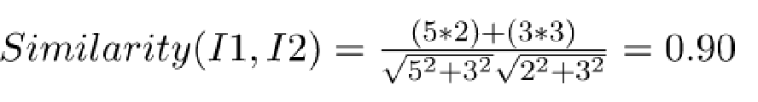
Calculating cosine similarity between I1 and I2

Slide 52
Sim(Item2, Item3):
User_3 and User_4 have rated for both the items 1 and 2. let I2 be vector for Item_2 and I3 be for Item_3.
Then, I2 = (3, 2) and, I3 = (1,2)
User/Item | Item_1 | Item_2 | Item_3
User_1 | 2 | – | 3
User_2 | 5 | 2 | –
User_3 | 3 | 3 | 1
User_4 | – | 2 | 2

Slide 53
Calculating cosine similarity between I2 and I3

Slide 54
Sim(Item1, Item3):
User_1 and User_3 have rated for both the items 1 and 2. let I1 be vector for Item_1 and I3 be for Item_3. Then, I1 = (2, 3) I3 = (3, 1)
User/Item | Item_1 | Item_2 | Item_3
User_1 | 2 | – | 3
User_2 | 5 | 2 | –
User_3 | 3 | 3 | 1
User_4 | – | 2 | 2

Slide 55

Calculating cosine similarity between I1 and I3

Slide 56
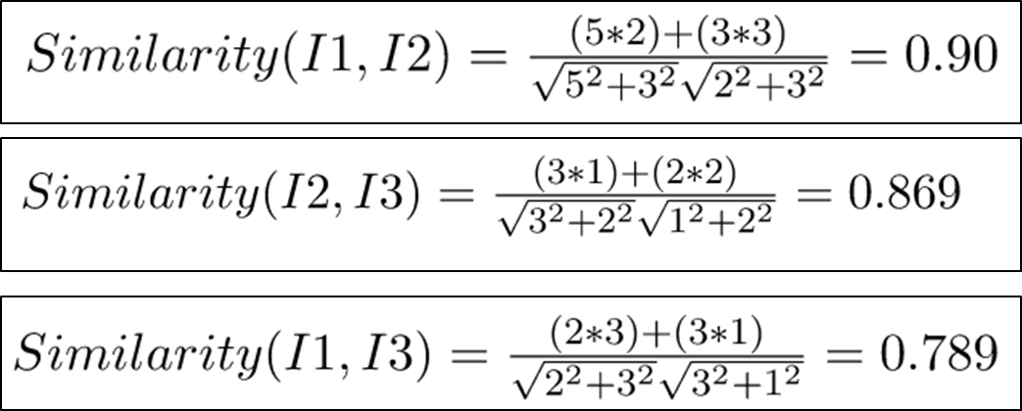

Slide 57



Step 2: Generating the missing ratings in the table
Calculate the ratings that are missing in the table.

Slide 58
Content-based filtering system
Content-Based recommender system tries to guess the features or behavior of a user given the item’s features, he/she reacts positively to.
Discovering Features of Documents:
Document collections and images are classes of items where the values of features are not immediately apparent.
There are many kinds of documents for which a recommendation system can prove to be useful.

Slide 59
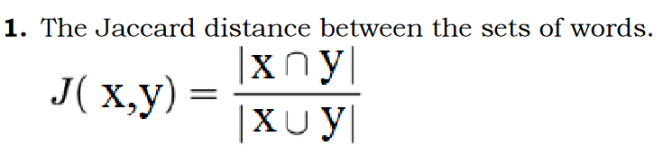
Example:
Web pages:
Many news articles published each day, and all cannot be read.
A recommendation system can suggest articles on topics a user is interested in.
Measuring similarity between two documents :

Slide 60

doc_1 = "Data is the new oil of the digital economy" doc_2 = "Data is a new oil" Find the set of unique words for each document. d1 = {'data', 'is', 'the', 'new', 'oil', 'of', 'digital', 'economy'} d2 = {'data', 'is', 'a', 'new', 'oil'} Calculate the intersection and union of these two sets
d1∩d2 = {'data', 'is', 'new', 'oil‘} = 4
d1Ud2 = {'data', 'is', 'the', ‘a’, 'new', 'oil', 'of', 'digital', 'economy'} = 9

Slide 61
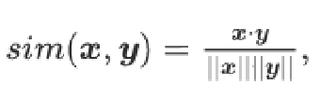


Cosine Similarity:
Suppose that x and y aretwo term-frequency vectors

Slide 62
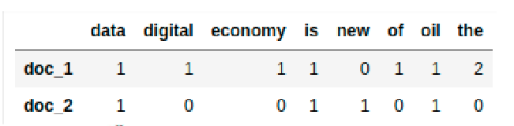
doc_1 = "Data is the oil of the digital economy"
doc_2 = "Data is a new oil"
# Vector representation of the document d1 = [1, 1, 1, 1, 0, 1, 1, 2] d2 = [1, 0, 0, 1, 1, 0, 1, 0]

Slide 63
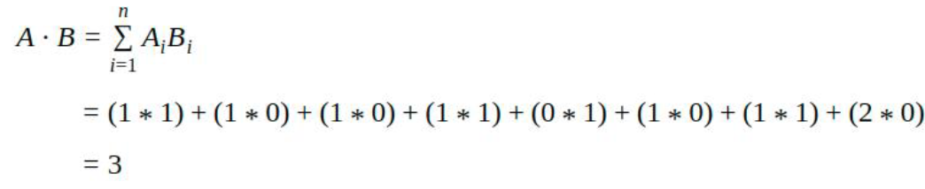
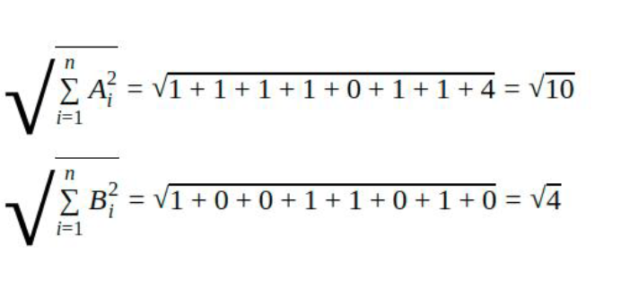


Slide 64
Item Profile in a content-based system
Each item is a profile, which is a record or a collection of records representing important characteristics of that item, is first constructed.
For example, for a movie recommendation system, the important characteristics are: 1. The set of actors of the movie. 2. The director. 3. The year in which the movie was made. 4. The genre or general type of movie, and so on.
The objective of content-based recommendation systems is to find and rank things (documents) according to the user preferences.

Slide 65
To find similarity between the items, Dice co-efficient given below is used. Let b1, b2 be two items.
Similarity between the two is given by
This approach has the basic assumptions that all keywords are of equal importance.

Slide 66
Term Frequency−Inverse Document Frequency
TF-IDF stands for “Term Frequency – Inverse Document Frequency ”. TF-IDF is a numerical statistic which measures the importance of the word in a document.
Term Frequency: Number of time a word appears in a text document.
Inverse Document Frequency: Measure the word is a rare word or common word in a document.
tf(t,d) = (Number of times term t appears in a document) / (Total number of terms in the document) Where,
tf(t,d) - Term Frequency,
t = term,
d = document idf(t) = log [ n / df(t) ] + 1

Slide 67
Consider a document which has a total of 100 words and the word “book” has occurred 5 times in a document.
Term frequency (tf) = 5 / 100 = 0.05
Assume that there are 10,000 documents and the word “book” has occurred in 1000 of these.
Then idf is: Inverse Document Frequency(IDF) = log[10000/1000] + 1
= 2 TF-IDF = 0.05 * 2 = 0.1

Slide 68
Obtaining Item Features from Tags
Consider that images of features have been obtained for items.
The problem with images is that their data, which is an array of pixels, does not tell us anything useful about their features.
To obtain information about features of items, request users to tag the items by entering words or phrases that describe the item.
But, the problem with tagging as an approach to feature discovery is that the process only works if users are willing to take the trouble to create the tags, and the number of erroneous tags are minimal/negligible when compared to total number of tags.

Slide 69
To compute the cosine distance between vectors, consider the movie recommendation system.
Suppose the only features of movies are the set of actors and the average rating.
Consider two movies with five actors each. Two of the actors are in both movies.
Also, one movie has an average rating of 3 and the other has an average of 4. The vectors look something like 0 1 1 0 1 1 0 1 3α 1 1 0 1 0 1 1 0 4α The last component represents the average rating with an unknown scaling factor α.

Slide 70
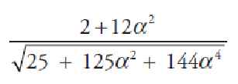
Computing in terms of α, the cosine of the angle between the vectors is
For α = 1, the cosine is 0.816. For α = 2, the cosine is 0.940,
the vectors are closer in direction if we use α = 1.

Slide 71
User Profiles
To consider the user profiles, vectors with the same components that describe user’s preferences are created. The utility matrix represents the connection between the users and the items.
The entries in the utility matrix to represent user purchases or a similar connection could be just 1s, or they could be any number representing a rating or liking that the user has for the item. This information can be used to find the best estimate regarding which items the user likes.
This is taken as aggregation of the profiles of those items.
If the utility matrix has only 1s, then the natural aggregate is the average of the components of the vectors representing the item profiles for the items in which the utility matrix has 1 for that user.

Slide 72
Example
Suppose items are movies, represented by Boolean profiles with components corresponding to actors.
If 25% of the movies that user U likes have Tom Hanks as one of the actors, then the user profile for U will have 0.25 in the component for Tom Hanks.
If the utility matrix has ratings 1–5, then we can weigh the vectors representing the profiles of items by the utility value.
The utilities are normalized by subtracting the average value for a user.

Slide 73
Eg.
User U gives rating for three movies as 1, 3 and 4. The user profile for U has, in the component will be Average(3) of 1 − 3, 3 − 3 and 4 − 3, that is, the value −1/3.
Therefore, items with a below-average rating get negative weights, and items with above-average ratings get positive weights.
The vector for a user will have positive numbers for actors who appear in movies the user likes and have negative numbers for actors appearing in movies the user does not like.

Slide 74
Case 1: Consider a movie with many actors the user likes, and only a few or none that the user does not like. The cosine of the angle between the user’s and movie’s vectors will be a large positive fraction. That implies an angle close to 0, and therefore a small cosine distance between the vectors.
Case 2: Consider a movie with as many actors that the user likes as those the user does not like. In this situation, the cosine of the angle between the user and movie is around 0, and therefore the angle between the two vectors is around 90°.
Case 3: Consider a movie with mostly actors the user does not like. In that case, the cosine will be a large negative fraction, and the angle between the two vectors will be close to 180°– the maximum possible cosine distance.

Slide 75
What else ??????

Slide 76
Transforming ratings
The data captured in the utility matrix can be transformed by applying well-defined rules to every element in the matrix.
Two common transformations are:
rounding and
normalizing.

Slide 77
Rounding the data
Viewers typically give similar ratings to similar movies.
For example:
Viewer B has given high ratings to all Harry Potter movies,
viewer C has highly rated Star Wars 1 and Star Wars 2.
This similarity in ratings can be removed by rounding the ratings with a rule.
For example, we can set a rule to round ratings 3, 4, and 5 to 1, and consider ratings 1 and 2 as blank spaces. After applying this rule, our utility matrix becomes:

Slide 78
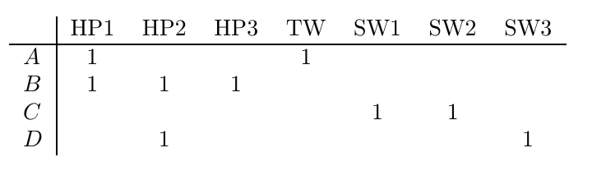
Intersection of sets corresponding to viewers A and C is a null set.
This reduces the Jaccard similarity to its minimum value zero, and shoots the Jaccard distance to its maximum value 1.
Jaccard distance between the sets corresponding to viewers A and B is less than 1 which makes A closer to B than to C.
Note that Jaccard distance measure didn’t provide this insight into user behaviour when the distance was calculated using the original user ratings.
Finding cosine distances with rounded off values leads to the same conclusion.

Slide 79
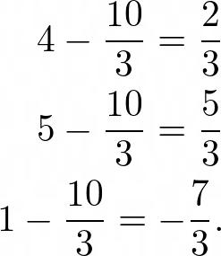
Normalised ratings
Normalising means subtracting from each rating, the average rating of that individual viewer.
Normalised ratings for the viewer A whose average rating is 10/3. The normalised ratings will be
 | HP1 | HP2 | HP3 | TW | SW1 | SW2 | SW3
A | 4 |  |  | 5 | 1
B | 5 | 5 | 4
C |  |  |  | 2 | 4 | 5
D |  | 3 |  |  |  |  | 3

Slide 80
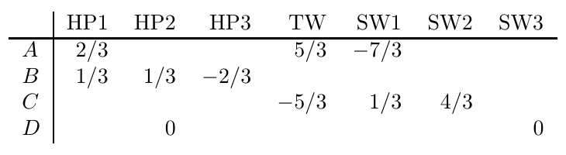
Utility matrix with normalized values
Note that this turns higher ratings into positive values, and lower ratings into negative values.
Since individual values are changed in the utility matrix, we can expect the cosine distances to change.
Jaccard distance remains unchanged as it depends only on the number of movies rated by both the users, but not on the ratings given.

Slide 81
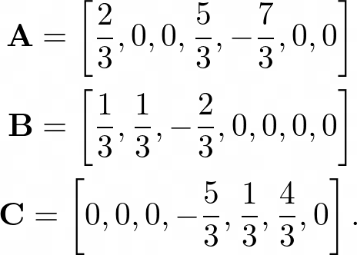
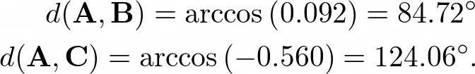
With normalised values, the vectors corresponding to viewers A, B, and C are
The cosine distances between A and B, and A and C are:

Slide 82
Jaccard or Cosine????
Jaccard distance takes into account the number of products rated by both the users that are being compared, but not the actual value of the rating itself.
Cosine distance, on the other hand, takes into account the actual value of the rating, but not the number of products rated by both the users.
Because of this difference in calculating distances, Jaccard and cosine distance measures can sometimes lead to conflicting predictions.
In some cases, such conflicts can be avoided by rounding off the ratings according to a well defined rule.

Slide 83
THANK YOU

